Slide 1

KATIHAR ENGINEERING COLLEGE,KATIHAR (Department of Computer science & Engineering)
BIHAR ENGINEERING UNIVERSITY,PATNA
SUBMITTED BY :
NAME:- Pravin Raj,Gyanendu,Bhawana Kumari
SEMESTER:-7th Sem
SUBJECT :- Seminar
SUBMITTED TO :
Prof. Dr. Dharmveer Kumar Yadav

Slide 2
LAPTOP PRICE PREDICTION
Using
Machine Learning

Slide 3

Title: Problem Statement
Problem: The pricing of laptops can be highly variable based on various factors such as brand, specifications, market trends, and consumer demand.
Challenge: Consumers and businesses often struggle to determine the fair price for a laptop, and businesses need better pricing strategies to stay competitive.
Objective: To create a machine learning model that can predict the price of laptops based on various features such as CPU, RAM, screen size, storage, brand, and more.

Slide 4
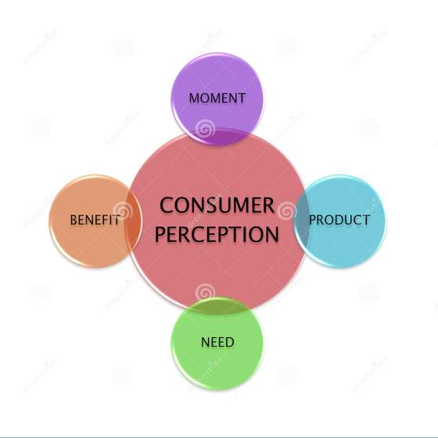
Title: Business Need Assessment
Consumer Perspective:
Consumers want to make informed decisions when purchasing laptops, ensuring they are getting the best value.
Price transparency is crucial in influencing buying decisions.
Business Perspective:
Businesses in the laptop industry (manufacturers, retailers) need effective price optimization strategies to remain competitive and improve margins.
Accurate price prediction models can aid in market positioning and promotion strategies.
Stakeholders:
Retailers, e-commerce platforms, consumers, manufacturers, and analysts.

Slide 5
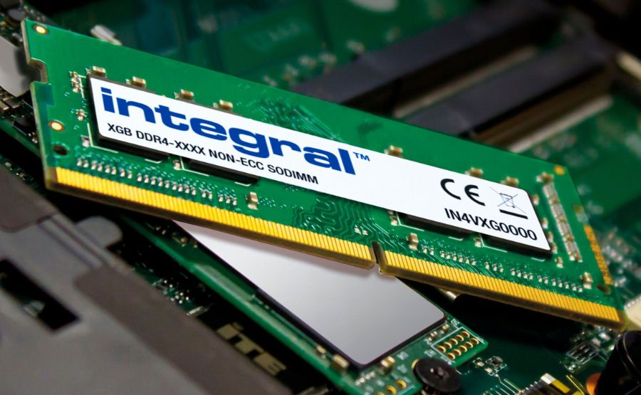
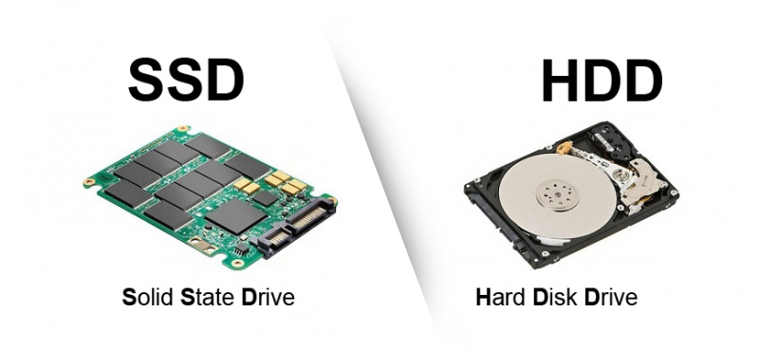
Title: Target Specification
Laptop Features: CPU type, RAM size, storage (SSD/HDD), screen size, graphics card, brand, release year, etc.
Target Variable: Price of the laptop.
Prediction Goal: Predict the price based on input features.
Performance Metrics: Mean Absolute Error (MAE), Root Mean Square Error (RMSE), R² score.

Slide 6


Title: Benchmarking Alternate Products
Competitor Analysis: Research on existing laptop pricing platforms and their methodologies (e.g., Amazon, BestBuy, PriceGrabber).
Alternatives: Comparison of laptop price prediction tools or platforms using simpler techniques (e.g., regression models) vs. complex techniques (e.g., deep learning models).
Challenges of Alternatives:
Lack of accuracy due to non-linear price drivers.
Inability to capture real-time price fluctuations.

Slide 7
Title: Concept Development
Machine Learning Approach:
Data Collection: Gather historical data on laptops from sources like e-commerce platforms (Amazon, Flipkart) including their specifications and prices.
Feature Engineering: Identify relevant features such as processor type, RAM, storage, etc., which impact laptop prices.
Model Selection: Choose algorithms like Linear Regression, Random Forest, or XGBoost for predicting the price based on the features.
Model Evaluation: Test the model on unseen data and tune hyperparameters to improve accuracy.
Outcome: A model that can predict the price of any given laptop based on its specifications

Slide 8
Title: Code Implementation
Libraries Used:
Pandas for data manipulation.
Scikit-learn for machine learning models.
Matplotlib/Seaborn for data visualization.
Steps in the Code:
Load the dataset and preprocess it (handling missing values, encoding categorical features).
Split the data into training and testing sets.
Train different models (e.g., Linear Regression, Random Forest) and evaluate their performance.

Slide 9
Title: Business Model
Monetization Strategy:
Subscription Model: Offer premium features such as advanced predictions for e-commerce platforms and retailers.
Advertising Revenue: Integrate with online marketplaces to offer insights into competitor pricing.
Consulting Services: Provide businesses with tailored pricing models.
Target Market:
E-commerce platforms, laptop manufacturers, and online retailers.
Revenue Stream:
Subscription fees for access to predictions.
Analytics for marketing strategies and demand forecasting.

Slide 10
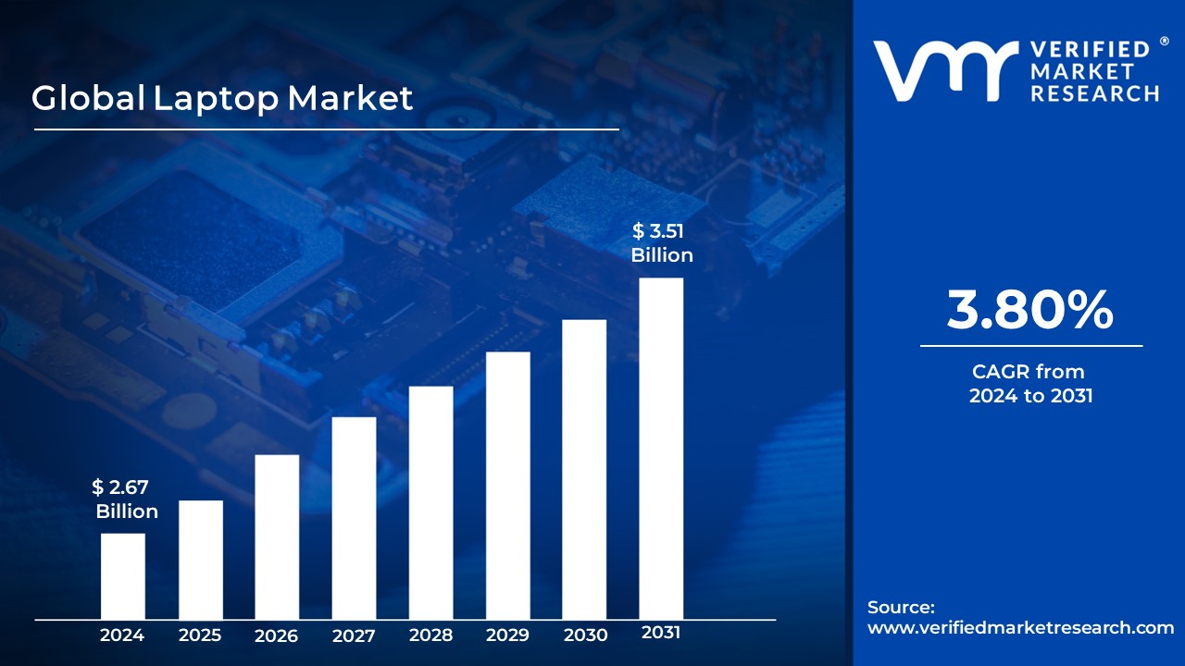
Title: Market Analysis
Market Size & Growth: The global laptop market is expanding, with increasing demand for e-commerce platforms.
Trends:
Rise in online shopping platforms.
Increased focus on AI and machine learning in retail and pricing.
Competitive Landscape: Overview of key players in the laptop sales space, their market share, and how they handle pricing.

Slide 11
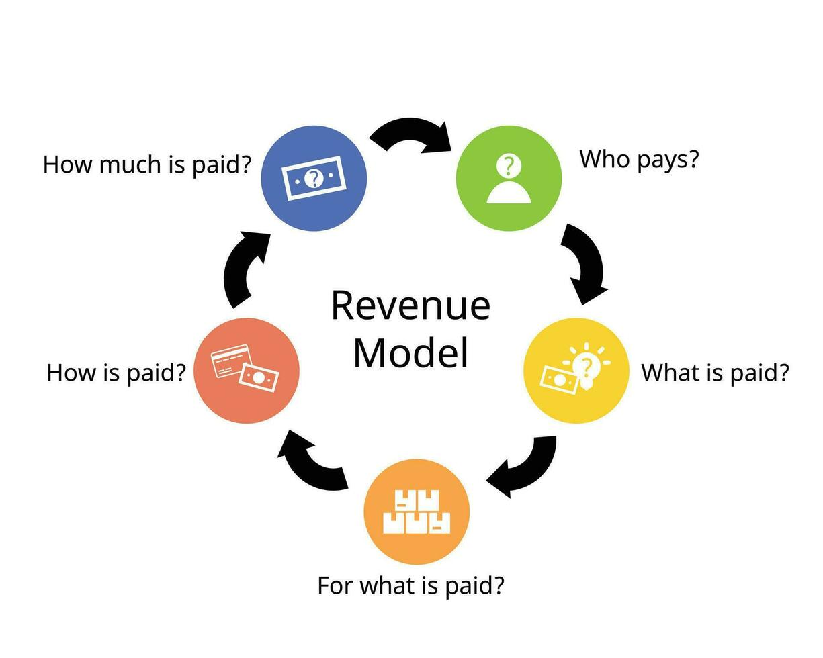
Title: Financial Equation
Cost Breakdown:
Data Collection Costs: License for datasets or web scraping infrastructure.
Model Development: Cost of cloud computing resources, model training, and tuning.
Maintenance: Regular updates to the model and continuous learning.
Revenue Model:
Subscription pricing based on number of users/clients.
Example Financial Projection (e.g., monthly subscription fee of $100 with 50 clients generates $5,000/month).

Slide 12
Conclusion
Summary: Predicting laptop prices using machine learning is a valuable tool for consumers and businesses alike. By leveraging data-driven models, we can enhance pricing strategies, improve customer satisfaction, and optimize revenue.
Future Scope: Exploration of more complex models (e.g., neural networks) and real-time pricing adjustments based on market trends.
Call to Action: Implementing machine learning for dynamic price prediction is the way forward for a data-driven pricing strategy.

Slide 13


